Slide 1
Class 6
Mini Presentations - part 1
16.5.2017

Slide 2
momentum, learning rate, weight decay
Heli & Nitzan

Slide 3
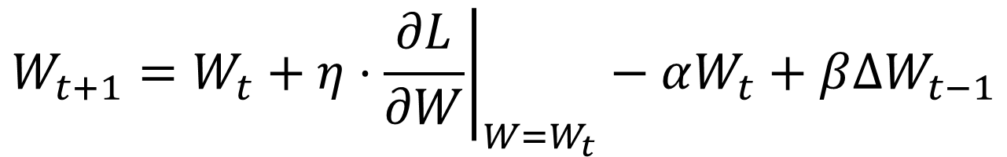
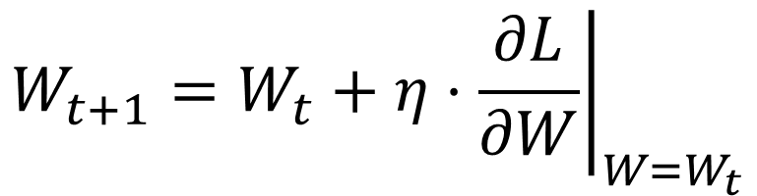
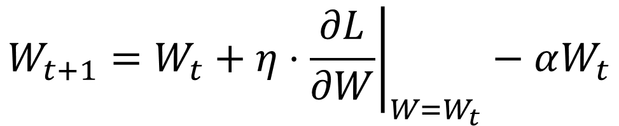

Learning rate, weight decay and momentum
Usually (in step-based optimization), weights steps are multiplied by some constant called the learning rate.
Weight decay is a regularization methods, pushing the weights to zero
Momentum is a stabilization method, remembering the last weights update

Slide 4
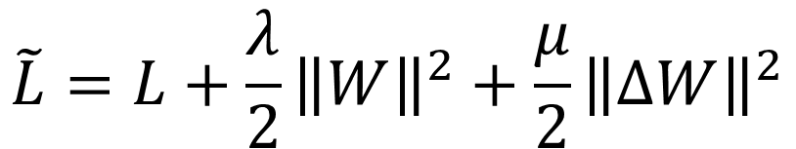
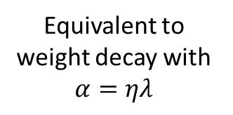
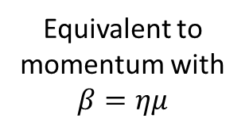
Weight decay and momentum as regularizers
Usage example (Keras):
sgd = optimizers.SGD(lr=0.01, decay=1e-6, momentum=0.9)
model.compile(loss='mean_squared_error', optimizer=sgd)

Slide 5
All types of Relu activations
Tzahi

Slide 6
*(R)ELU* Activation Functions:
Relu, Relu6, cRelu, pRelu, elu, leaky-Relu
DNN Challenge, Tzahi

Slide 7
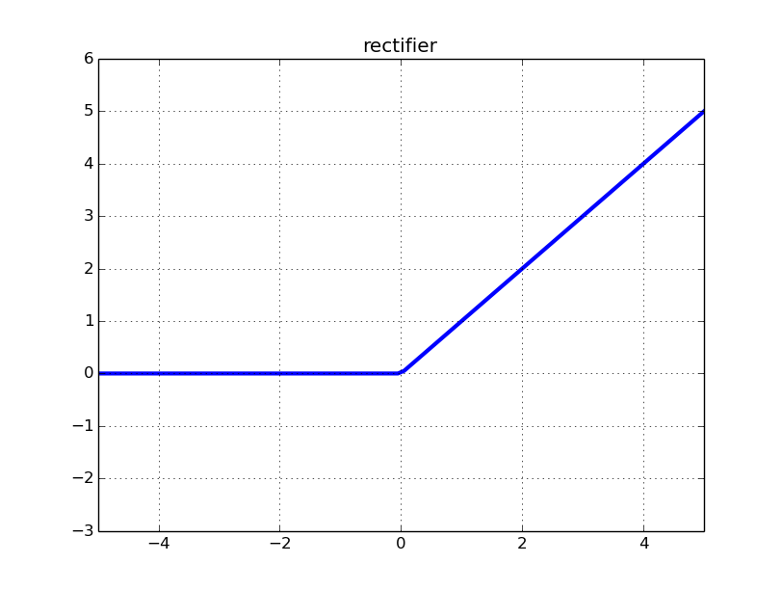
Relu = Rectifier linear unit = max(Wx+b,0)
  Sparsity for a<=0
  Deals better with vanishing gradients (as opposed to sigmoid)
  Non-Zero centered
  Unbounded
  “Dying Relu” neuron (grad = 0 → no update)
Relu6 = min(max(Wx+b,0),6)
  Bounded Relu
  Similar to hard-sigmoid
cRelu = Concatenated Relu
  Offered in a 2016 paper for improving vision-CNNs
  cRelu(x) = Relu(x) concat. Relu(-x) (R → R² )
  Double amount of output!

Slide 8
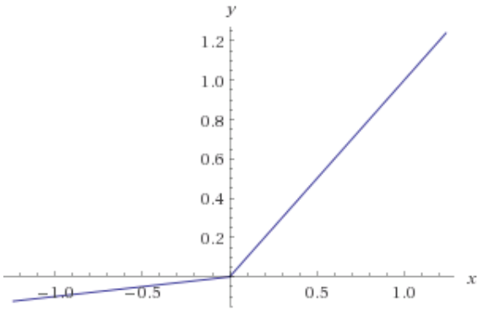



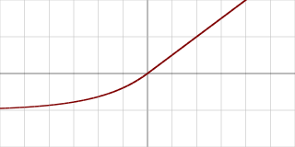
Leaky-Relu
  Addresses dying Relus
  Not implemented in TF but:
  tf.maximum(alpha*x,x)
pRelu = parametric Relu
  Generalization of the last
  You learn the parameter a
  No TF implementation
Elu = exponential linear units
  Tries to get mean activation closer to zero
  Smooth at zero
  In TF, a=1

Slide 9
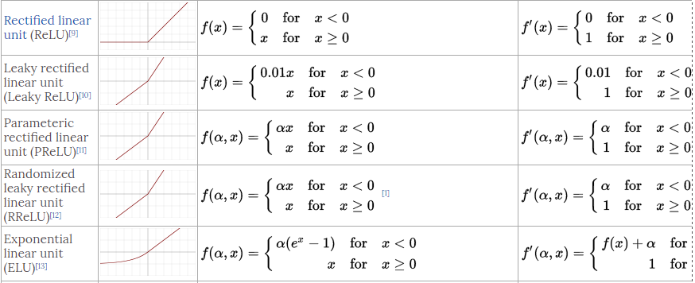
All takes the form:
  tf.nn.*(R)elu*(FEATURES, NAME=‘ ’), Returns a Tensor
Partial summary -

Slide 10
Other activations: sigmoid, tanh, softsign, softplus
Liad & Sivan

Slide 11
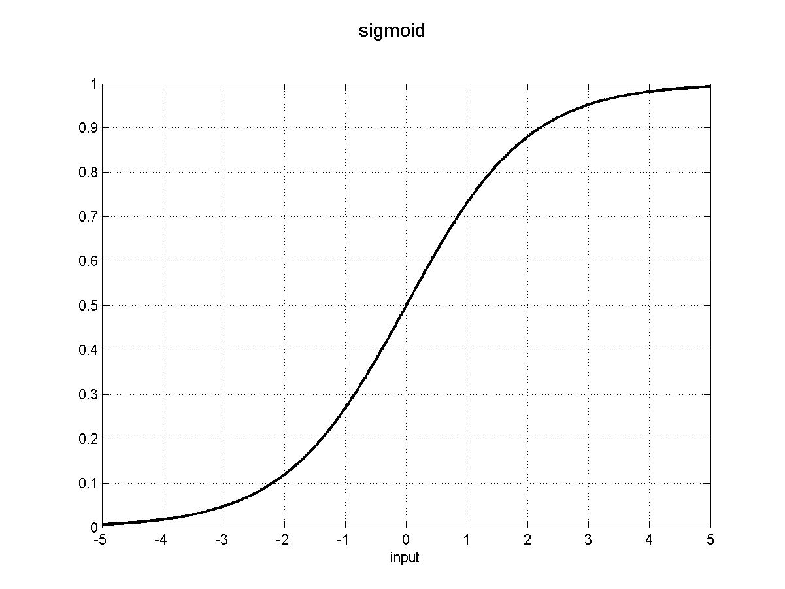
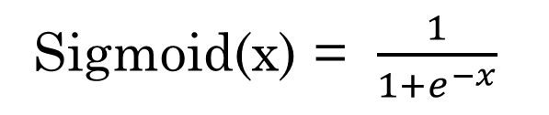
Sigmoid
tf.sigmoid(x, name=None)
Easy to compute | Zero centered | Vanishing gradients | Activation
No ☹ | No ☹ | Yes ☹ | Sigmoid

Slide 12
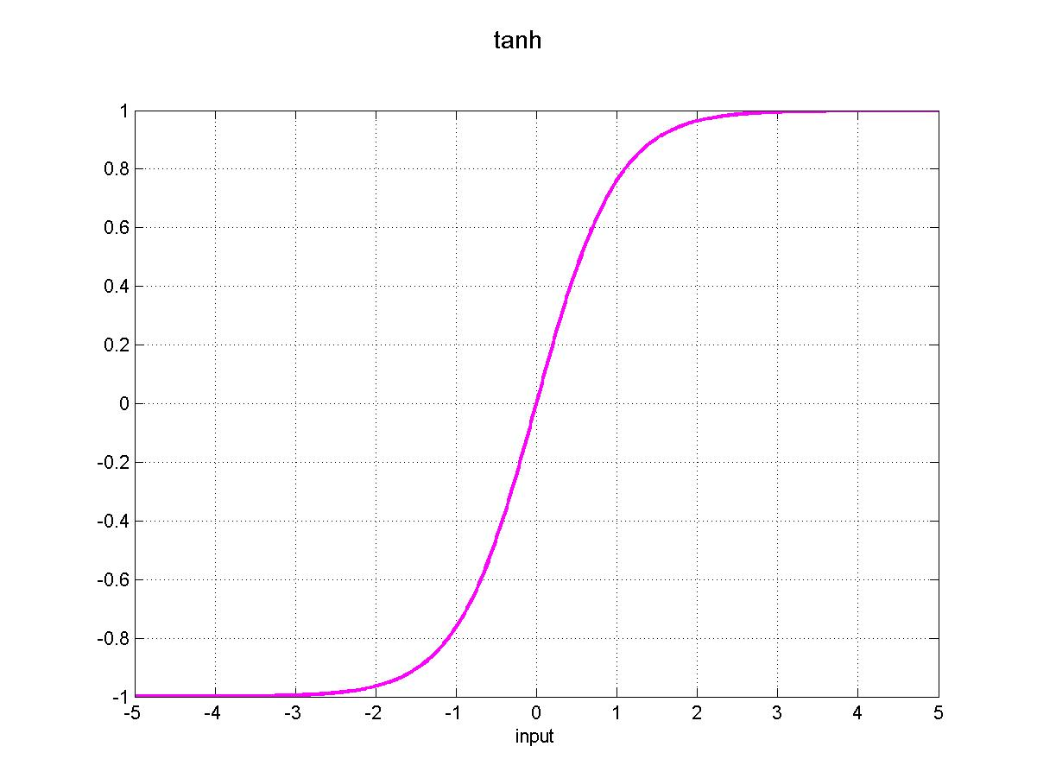
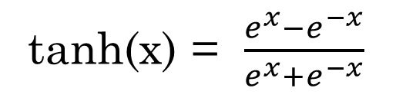
Tanh
tf.tanh(x, name=None)
Easy to compute | Zero centered | Vanishing gradients | Activation
No ☹ | No ☹ | Yes ☹ | Sigmoid
No ☹ | Yes ☺ | Yes ☹ | tanh

Slide 13
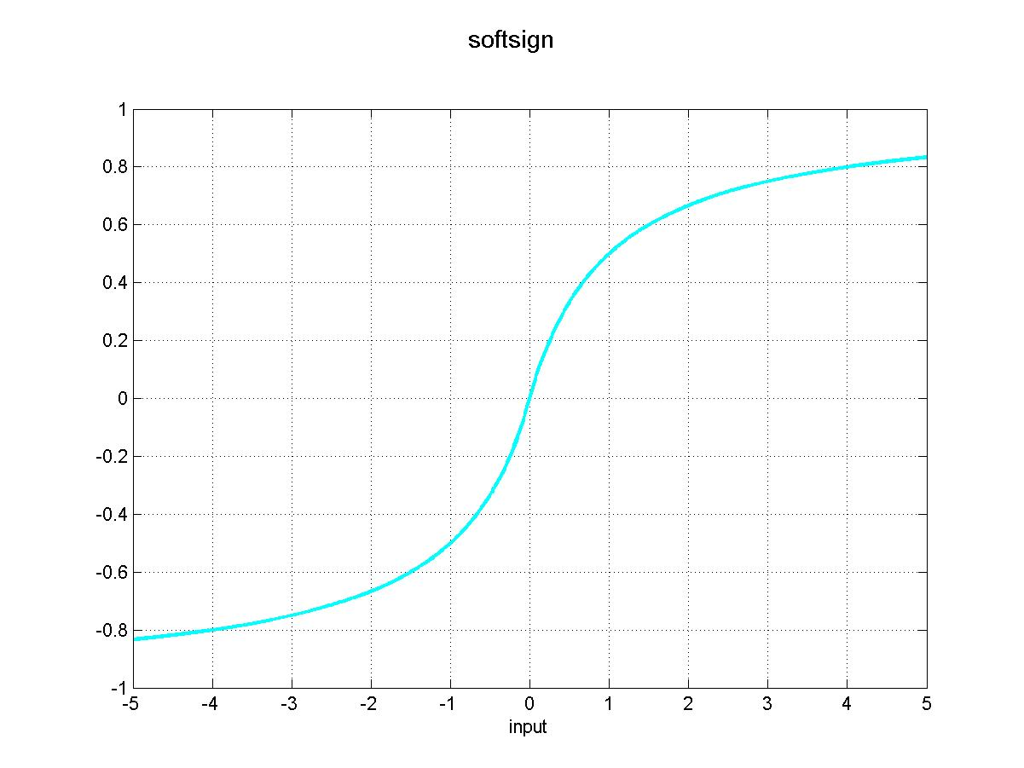
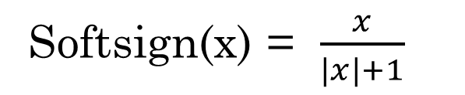
Softsign
tf.nn.softsign(features, name=None)
Easy to compute | Zero centered | Vanishing gradients | Activation
No ☹ | No ☹ | Yes ☹ | Sigmoid
No ☹ | Yes ☺ | Yes ☹ | tanh
Yes ☺ | Yes ☺ | Yes ☹ | softsign

Slide 14
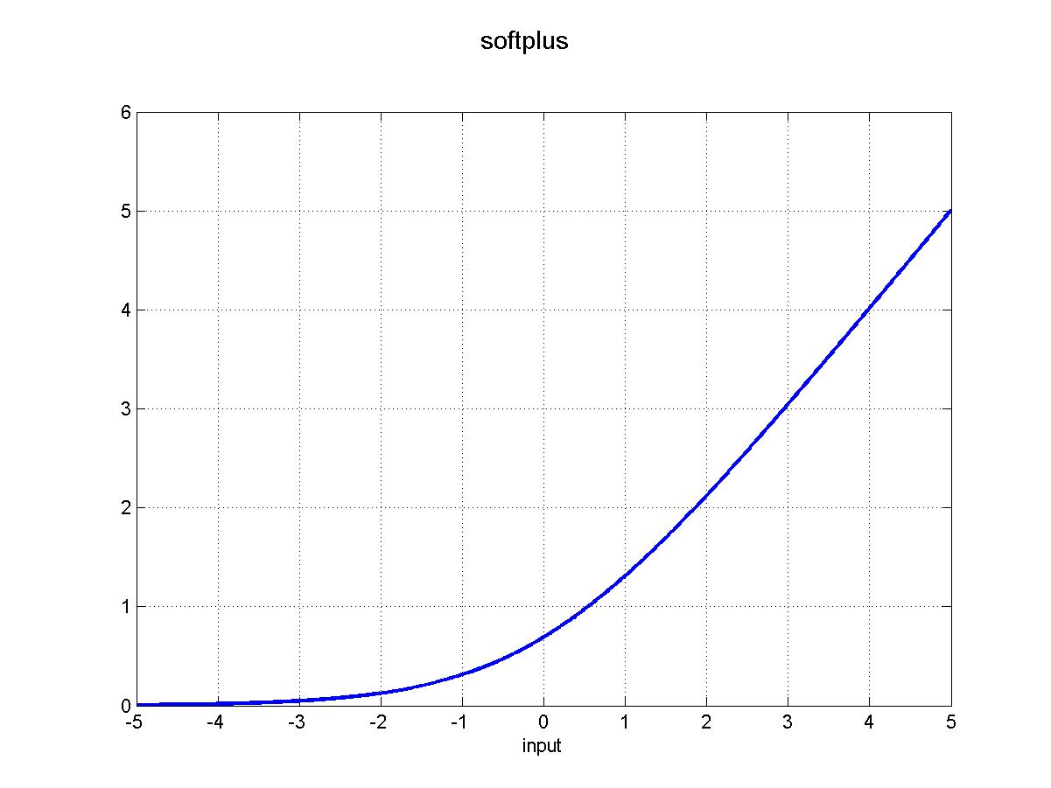
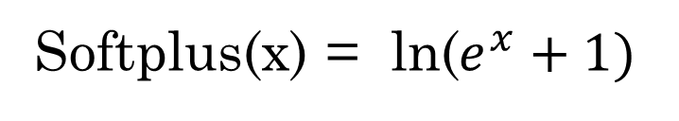
Softplus
tf.nn.softplus(features, name=None)
Easy to compute | Zero centered | Vanishing gradients | Activation
No ☹ | No ☹ | Yes ☹ | Sigmoid
No ☹ | Yes ☺ | Yes ☹ | tanh
Yes ☺ | Yes ☺ | Yes ☹ | softsign
Yes ☺ | No ☹ | No ☺ | softplus

Slide 15
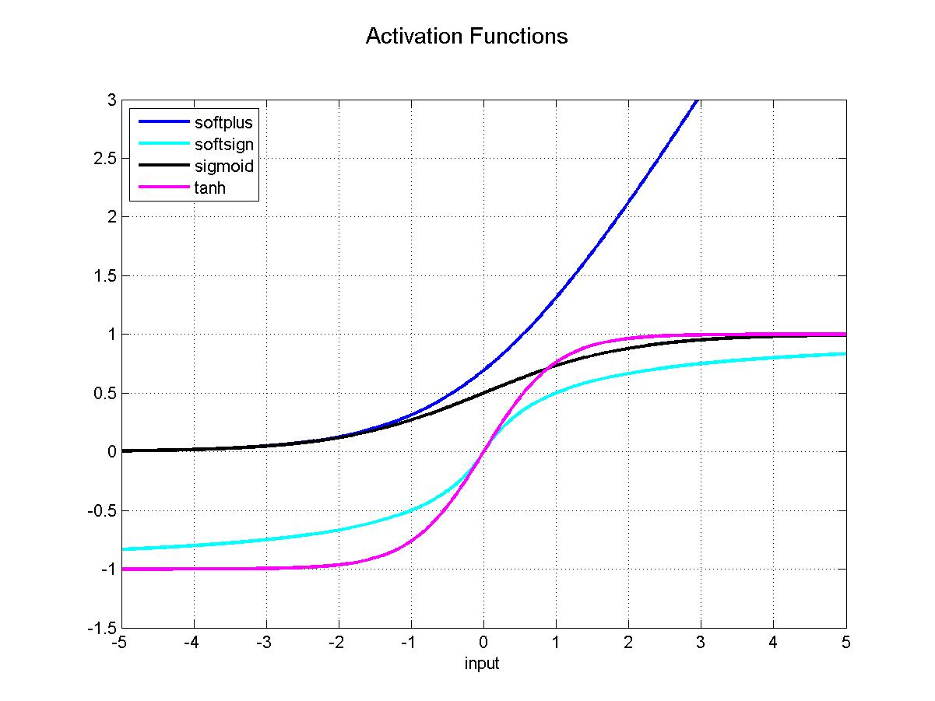
Activations
Easy to compute | Zero centered | Vanishing gradients | Activation
No ☹ | No ☹ | Yes ☹ | Sigmoid
No ☹ | Yes ☺ | Yes ☹ | tanh
Yes ☺ | Yes ☺ | Yes ☹ | softsign
Yes ☺ | No ☹ | No ☺ | softplus

Slide 16
Gradient descent
Aharon & Meytar

Slide 17
Gradient Descent and Variants
Meytar Zemer & Aharon Ravia

Slide 18
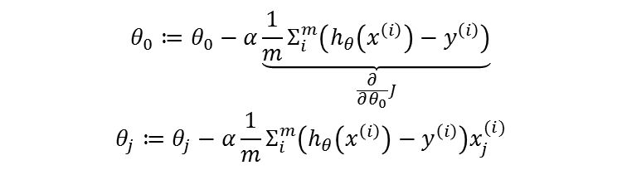
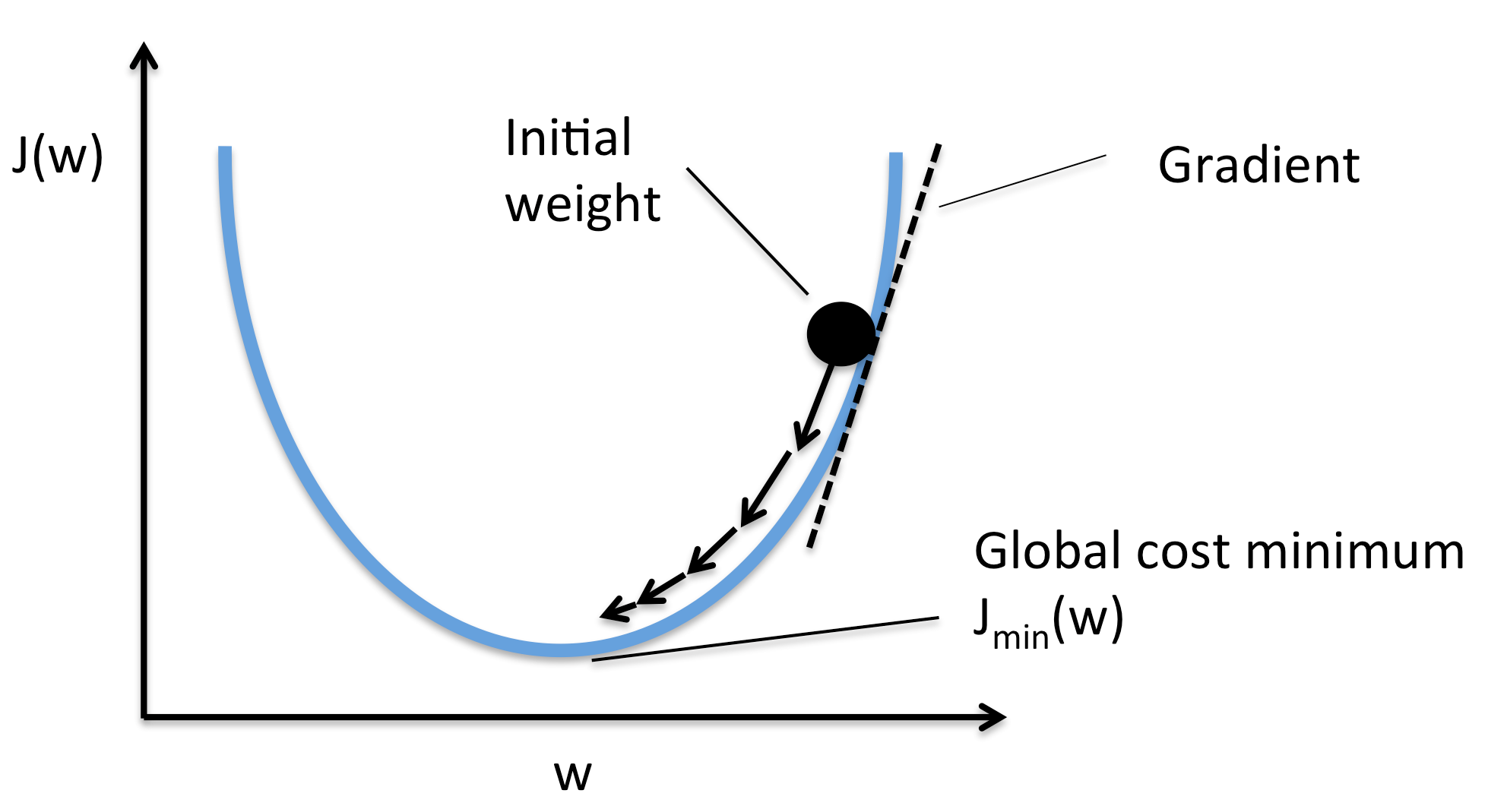
General algorithm overview
Parameters update:
An optimization algorithm
Motivation - minimize the cost function
Updates can generally be done in one of three ways:
  Batch optimization - go over all data and updates parameters (slow) – (m = N)
  Stochastic Gradient Descent (SGD) - updates one by one - (m = 1)
  Mini-batch - Something in between - (1 < m < N)
Notes:
*batch gradient descent can be very slow and is intractable for datasets that don't fit in memory. Batch gradient descent also doesn't allow us to update our model online, i.e. with new examples on-the-fly.
* SGD converges almost surely to a global minimum for pseudoconvex functions, and local when not
Mini - batch: a) reduces the variance of the parameter updates, which can lead to more stable convergence; and b) can make use of highly optimized matrix optimizations common to state-of-the-art deep learning libraries that make computing the gradient w.r.t. a mini-batch very efficient.

Slide 19
TensorFlow Implementation
The gradient descent optimization is done through: tf.train.GradientDescentOptimizer (A specific Optimizer)
One needs to define a target function for optimization
Once defined it is possible to work with batches of any size
minimize() -
compute_gradients()
apply_gradients()
loss = tf.reduce_mean(tf.pow(pred-y, 2))
optimizer = tf.train.GradientDescentOptimizer(learning_rate).minimize(loss)
(shuffle order of the examples)
for mini_batch_index in batch_index range:
x_, y_ = get_batch(train_X,train_Y, mini_batch_index)
_, c = sess.run([optimizer, loss], feed_dict={x: x_, y:y_})
Notes:
Comment: The loss function can be of any dimension (scalar / vector / matrix)

Slide 20

Questions?

Slide 21
xavier_initializer_conv2d, xavier_initializer
Roman

Slide 22
Xavier Initialization

Slide 23
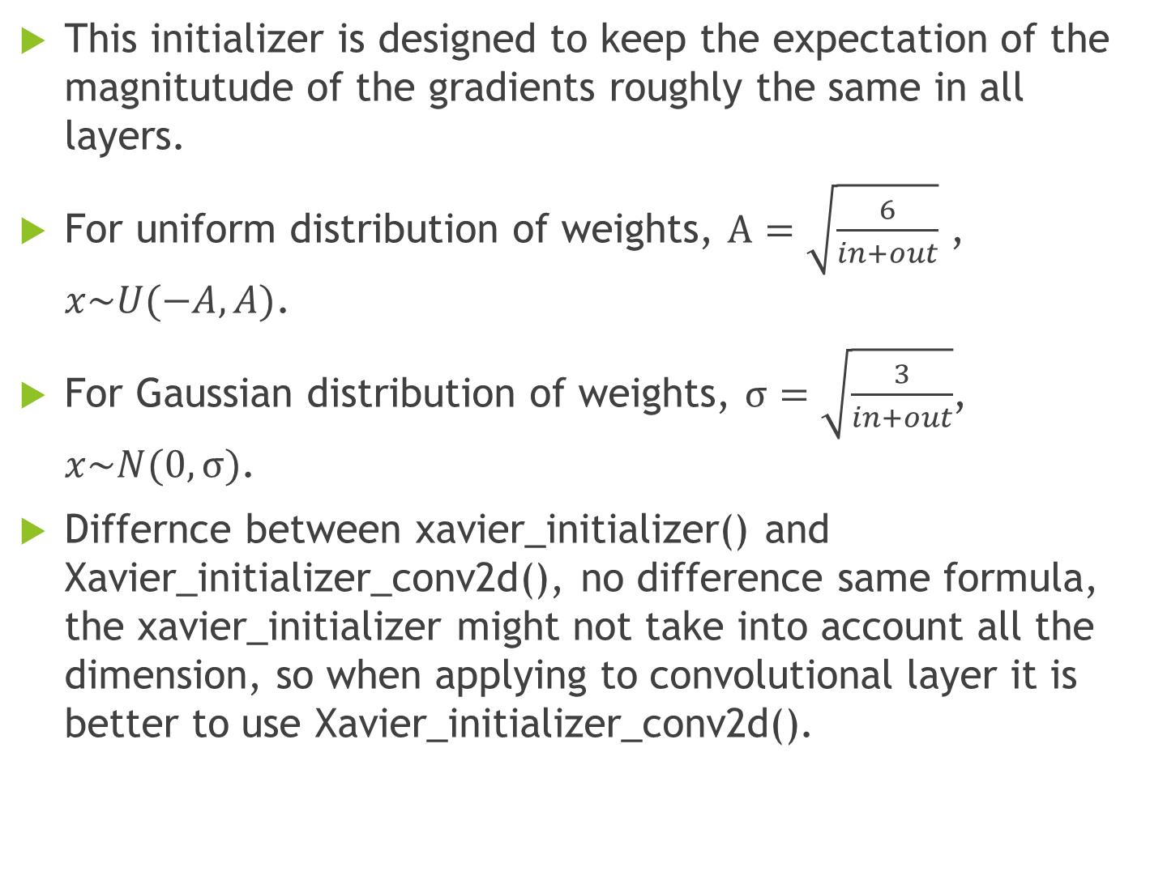

Slide 24
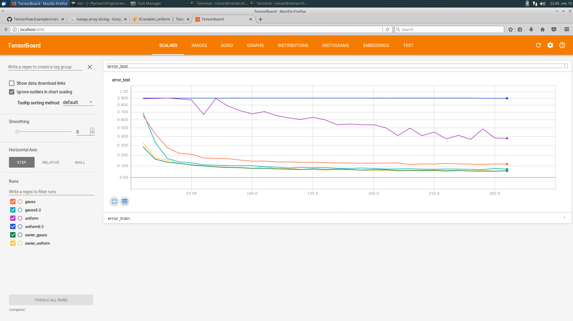
Example

Slide 25
How to use in Tensorflow
tf.get_variable('w', [n_input, n_output] , initializer = tf.contrib.layers.xavier_initializer())

Slide 26
Variance_scaling_initializer
Amnon

Slide 27
Variance scaling initializer

Slide 28
motivation
Initialization is crucial due to non convexity
Problematic initializations: too small, too large, all equal
Variance of layer with n inputs is n*var(w)*var(input)

Slide 29
Variance scaling
Initialize weights s.t n*var(w)=constant factor
Setting the standard deviation of the initializer to be sqrt(factor/n)

Slide 30
Implementation
tf.contrib.layers.variance_scaling_initializer(factor,mode,uniform,dtype)
Factor- the total variance of the vector after scaling
Mode - [FAN_IN,FAN_OUT,FAN_AVG]
Uniform- True/False
Dtype- the data type (only float supported)
tf.get_variable(name = ‘ ‘, shape = [ ] , initializer = tf.contrib.layers.variance_scaling_initializer(factor = 2, mode = ‘FAN_IN’,uniform = ‘False’))

Slide 31
Decaying learning rate
Yochai

Slide 32
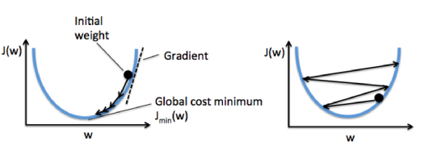
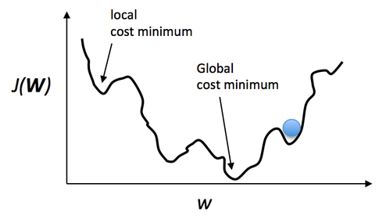
Decaying learning rate
learning rate | Pros | Cons
High Value | enable large initial gradient descent in the required direction | prevent from settle down into deeper, but narrower parts of the loss function.
Low value | Enable settle down into deeper, but narrower parts of the loss function. | Slow convergence into cost minimum point or even. settling down into a “local cost minimum” point instead of a global one.
Decaying learning rate - enable large initial gradient descent in the required direction
Enable settle down into deeper, but narrower parts of the loss function.

Slide 33
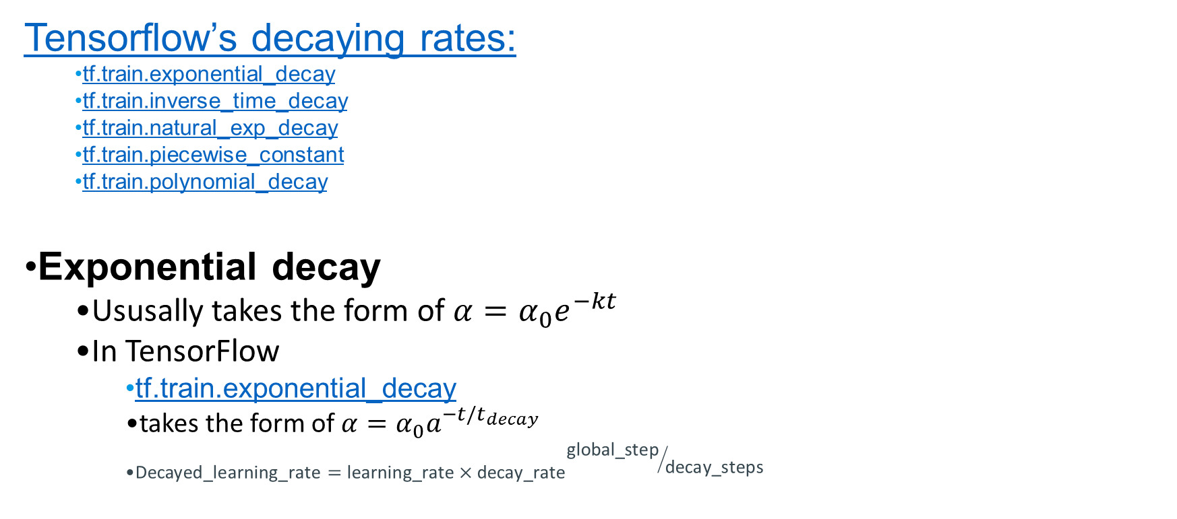
Decaying Learning Rate in Tensorflow

Slide 34
TensorFlow Exponential decay Example
tf.train.exponential_decay(learning_rate, global_step, decay_steps, decay_rate, staircase=False, name=None)
Example: decay every 100000 steps with a base of 0.96:
...
global_step = tf.Variable(0, trainable=False)
starter_learning_rate = 0.1
learning_rate = tf.train.exponential_decay(starter_learning_rate, global_step,
100000, 0.96, staircase=True)
# Passing global_step to minimize() will increment it at each step.
learning_step = (
tf.train.GradientDescentOptimizer(learning_rate)
.minimize(...my loss..., global_step=global_step)
)

Slide 35
Decaying learning rate
Yochai

Slide 36
Decaying learning rate
learning rate | Pros | Cons
High Value | enable large initial gradient descent in the required direction | prevent from settle down into deeper, but narrower parts of the loss function.
Low value | Enable settle down into deeper, but narrower parts of the loss function. | Slow convergence into cost minimum point or even. settling down into a “local cost minimum” point instead of a global one.
Decaying learning rate - enable large initial gradient descent in the required direction
Enable settle down into deeper, but narrower parts of the loss function.

Slide 37
Decaying Learning Rate in Tensorflow

Slide 38
TensorFlow Exponential decay Example
tf.train.exponential_decay(learning_rate, global_step, decay_steps, decay_rate, staircase=False, name=None)
Example: decay every 100000 steps with a base of 0.96:
...
global_step = tf.Variable(0, trainable=False)
starter_learning_rate = 0.1
learning_rate = tf.train.exponential_decay(starter_learning_rate, global_step,
100000, 0.96, staircase=True)
# Passing global_step to minimize() will increment it at each step.
learning_step = (
tf.train.GradientDescentOptimizer(learning_rate)
.minimize(...my loss..., global_step=global_step)
)

Slide 39
Ada-grad
Sigal & Elad

Slide 40
Adagrad – Adaptive Gradient
Tune learning rate for each parameter separately!
Per-parameter, decreasing, adaptive learning rate.
Parameters which had large gradients over time, will have smaller learning rates.
No need to tune learning rates.

Slide 41




Parameters to learn: ω in R^{d}
Objective function: Q(ω)
Gradient descent :
Adagrad descent: let and
then update
G_{j,j} is l₂ norm of previous derivatives w.r.t parameter j
  Can add ε>0, to avoid division by 0.

Slide 42
Adagrad – Adaptive Gradient
Weakness:
  Learning rate shrinks fast, eventually no more learning.
  No further learning of “old” parameters, after other parameters change dramatically

Slide 43
Ada-delta
Adi & Noam

Slide 44

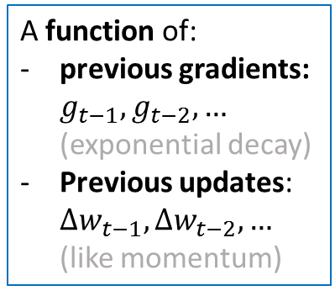


AdaDelta - Training Optimizer
Noam Bar
Adi Watzman
Improves AdaGrad weakness of learning rate converging to zero with increase of time.
Update rule:
=
X
Adaptive Learning Rate
Based on: http://int8.io/comparison-of-optimization-techniques-stochastic-gradient-descent-momentum-adagrad-and-adadelta, https://www.tensorflow.org/api_docs/python/tf/train/AdadeltaOptimizer

Slide 45
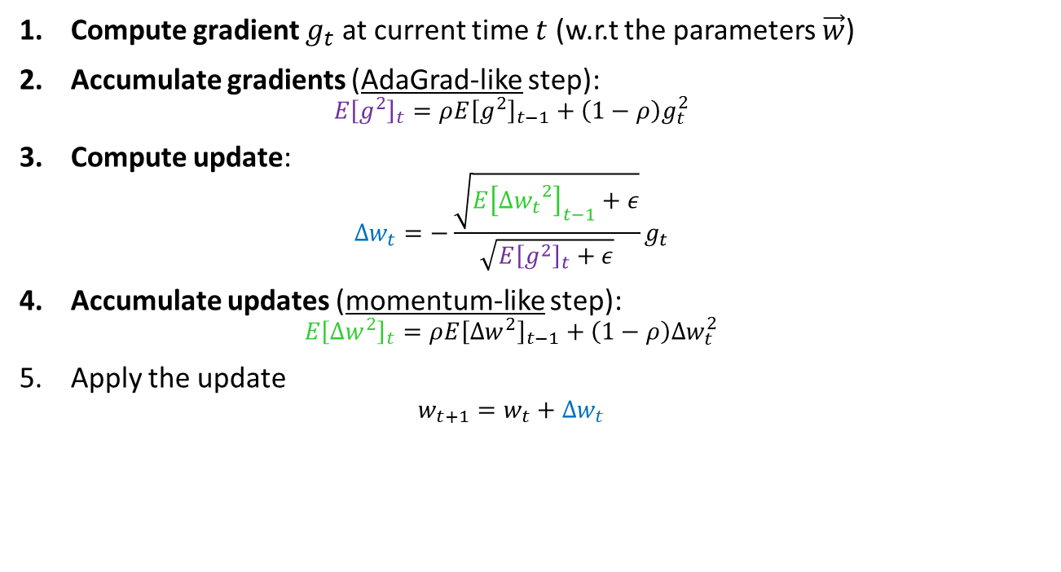
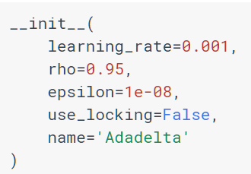
AdaDelta – Update Rule
optimizer = tf.train.AdadeltaOptimizer().minimize(loss)
(initial)
(If True use locks for update operations)

Slide 46
Momentum optimizer
Adam

Slide 47
Momentum

Slide 48
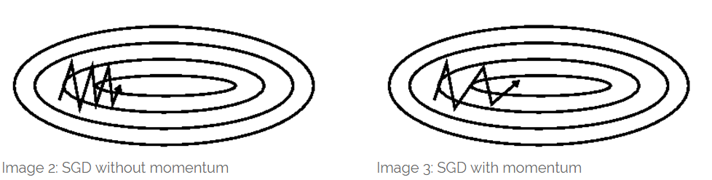
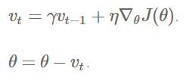
Why and What?
SGD Optimizers
Problem:
SGD has trouble navigating ravines
Solution:
Add a fraction γ from the update vector of the past time step to the current update vector
γ < 1 (usualy around 0.9)
The momentum term increases movement in dimensions whose gradients points to the same directions and reduces for dimensions whose gradients directions change

Slide 49
How to use in tensorflow
Under: tf.train.MomentumOptimizer
optimizer = tf.train.MomentumOptimizer(learning_rate, momentum, use_locking=False, name='Momentum', use_nesterov=False)
optimizer.minimize(loss, global_step=None, var_list=None, gate_gradients=GATE_OP, aggregation_method=None,
colocate_gradients_with_ops=False, name=None, grad_loss=None)

Slide 50
Adam
Niv & Hadar

Slide 51
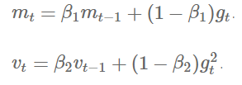
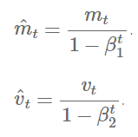
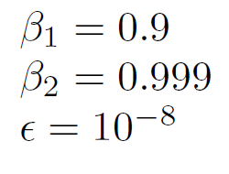

Adam - adative moment estimation

Slide 52
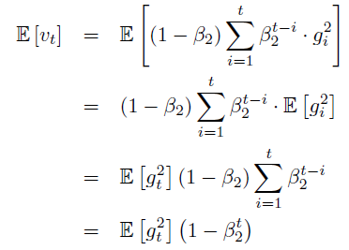
Adam - Debiasing

Slide 53
Batch normalizations
Tomer

Slide 54
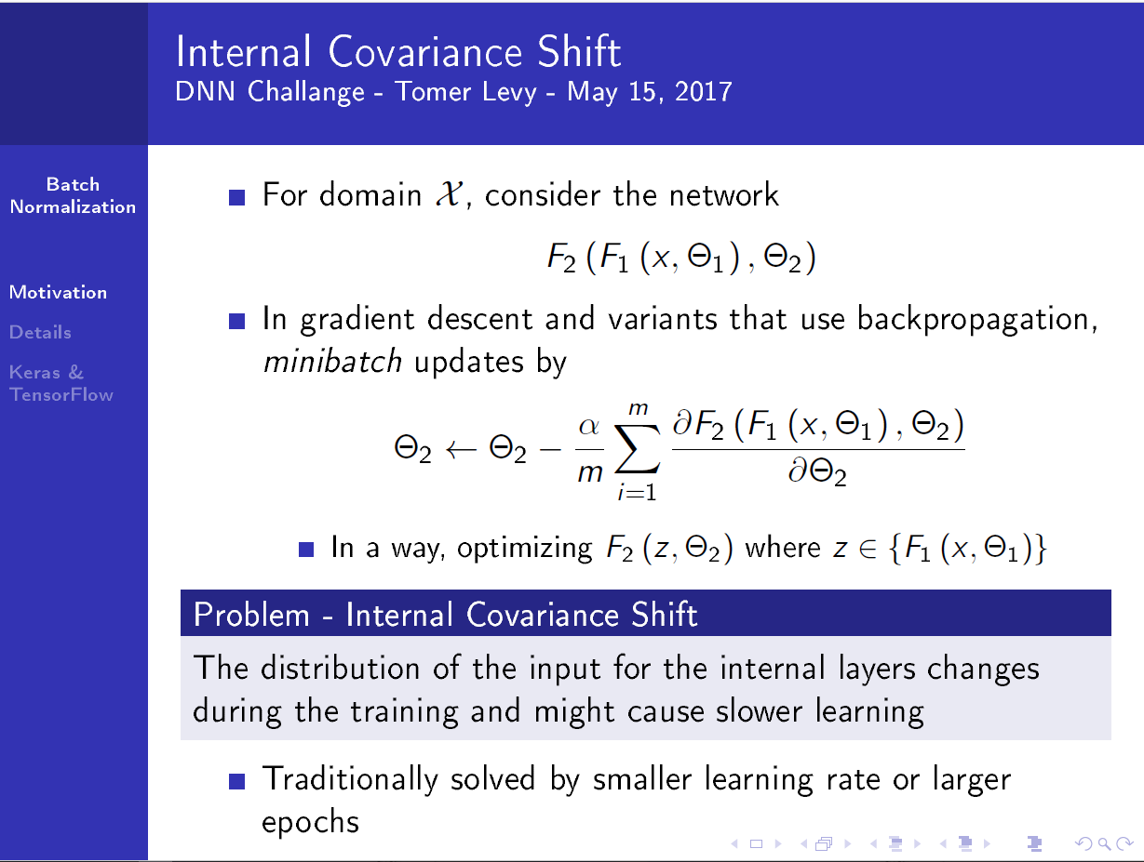

Slide 55
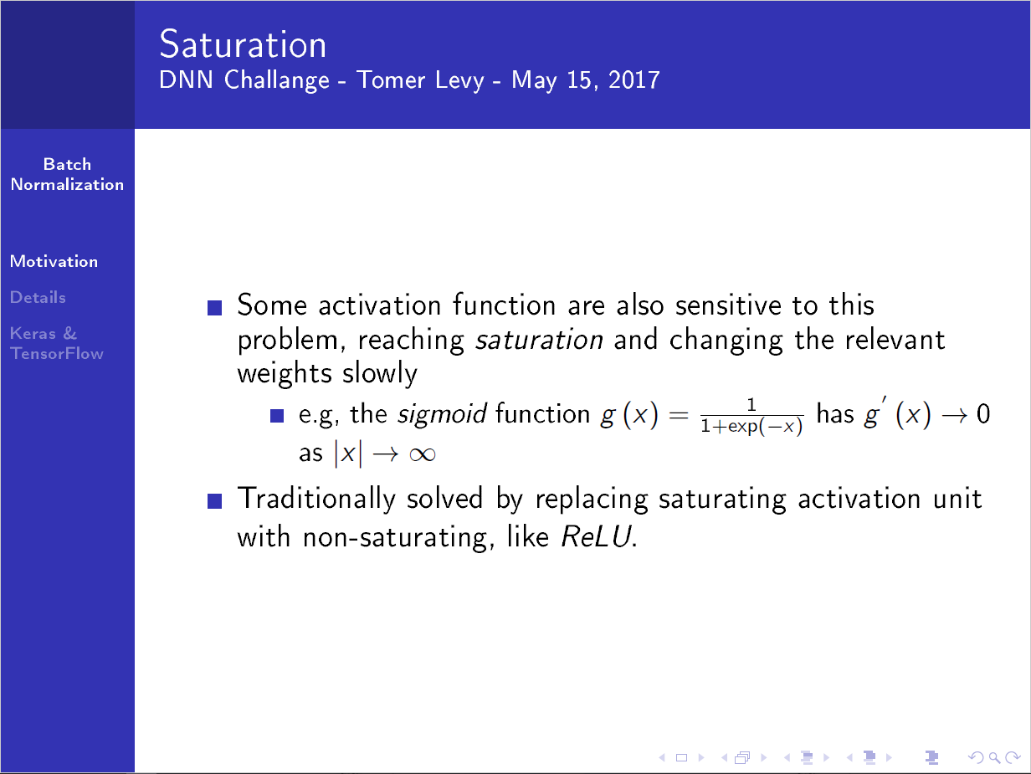

Slide 56
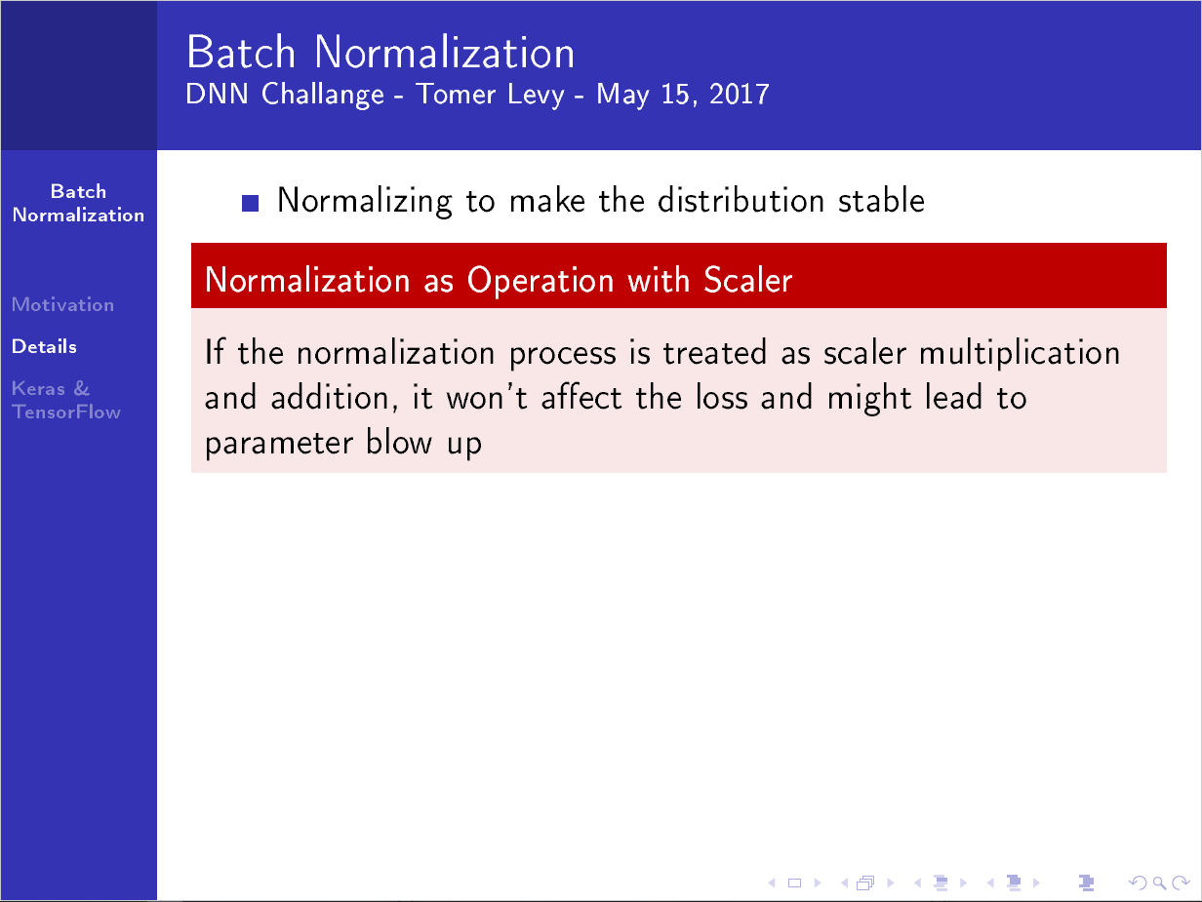

Slide 57
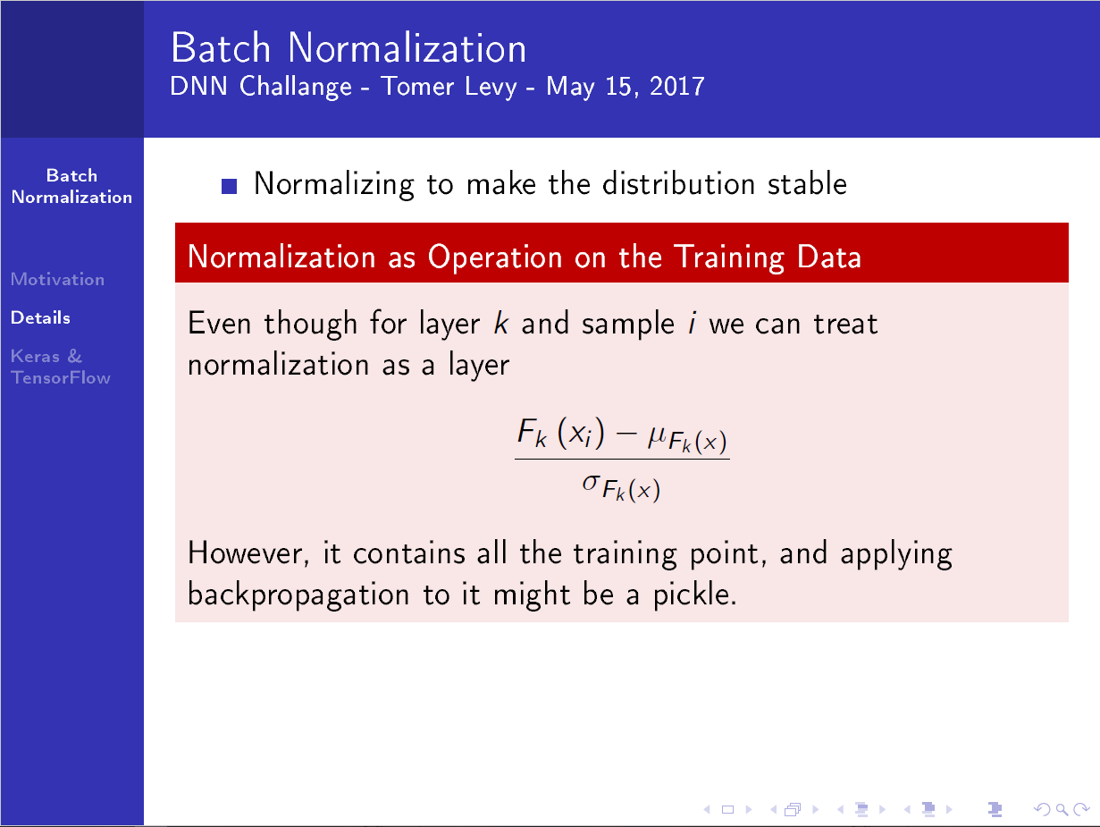

Slide 58
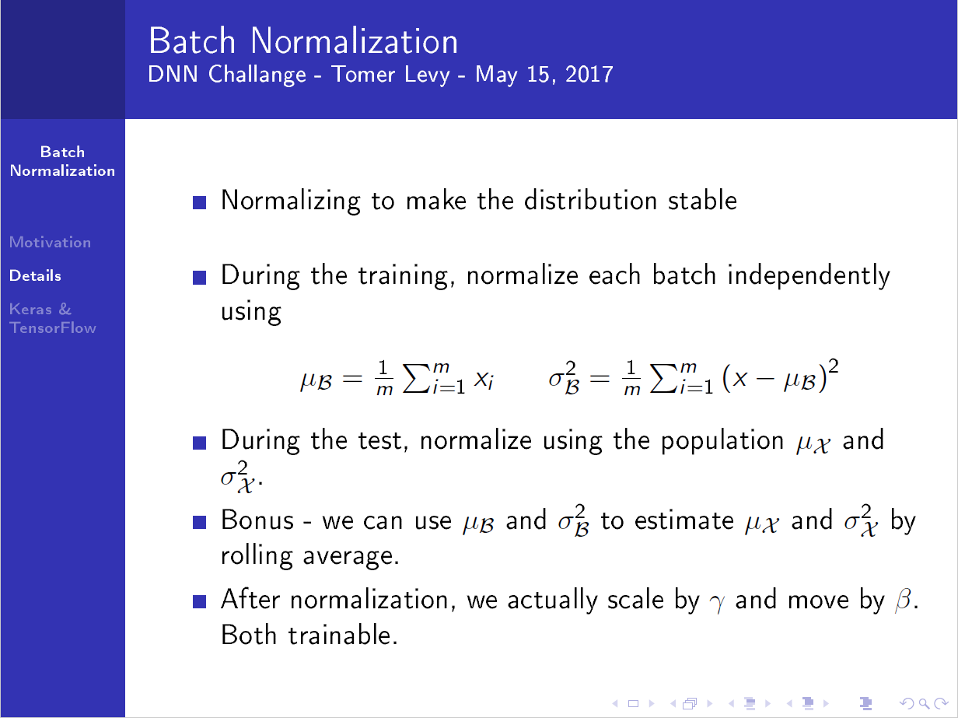

Slide 59
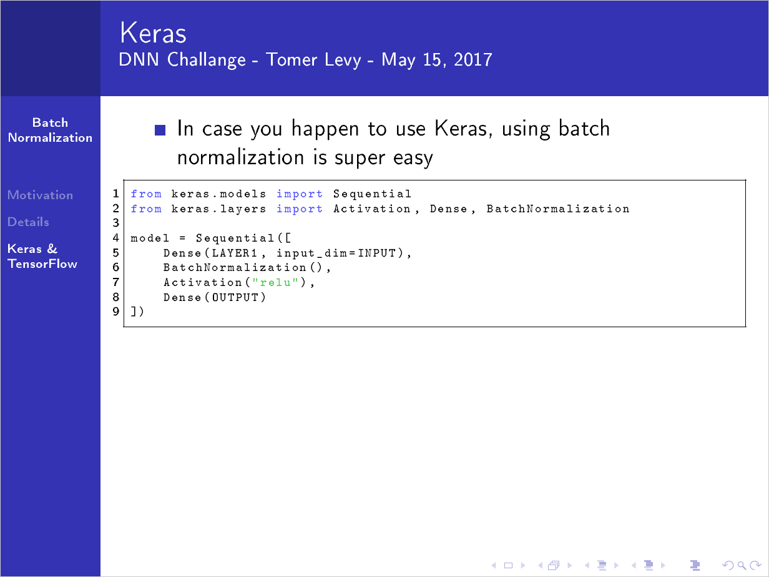

Slide 60
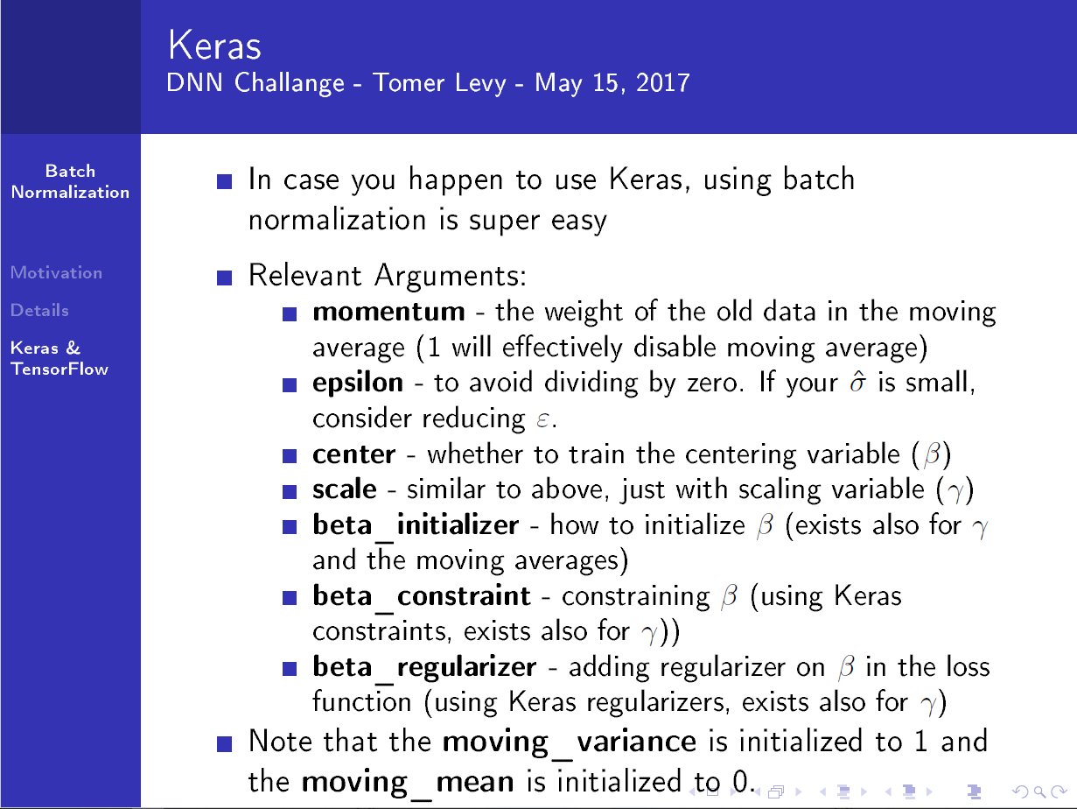

Slide 61
